Slide 1
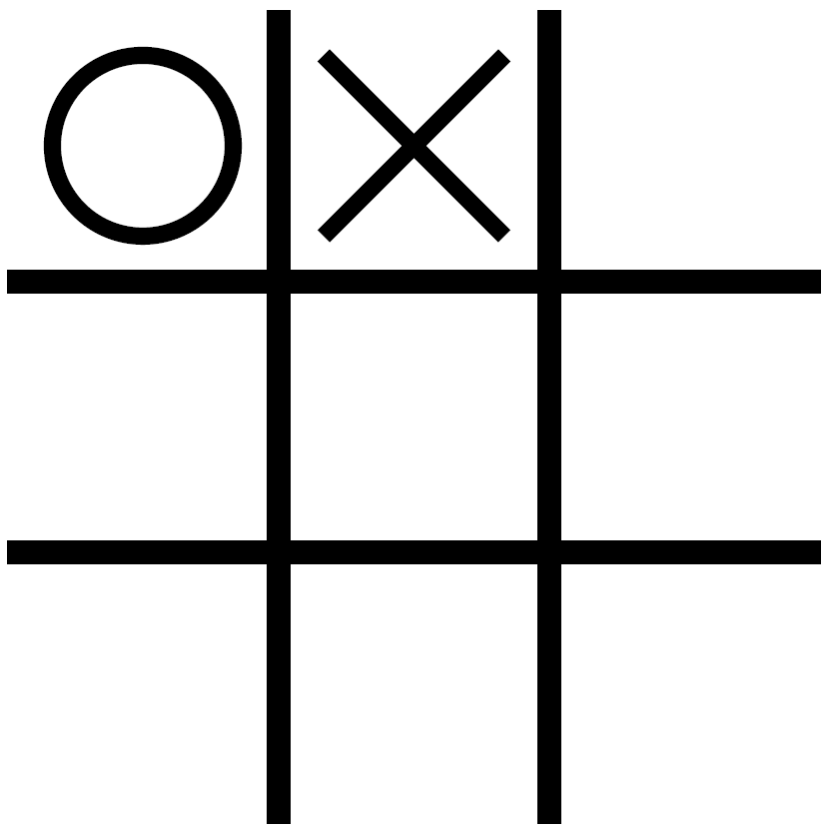
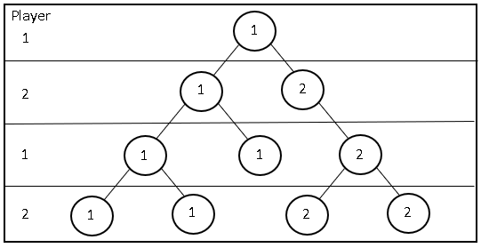
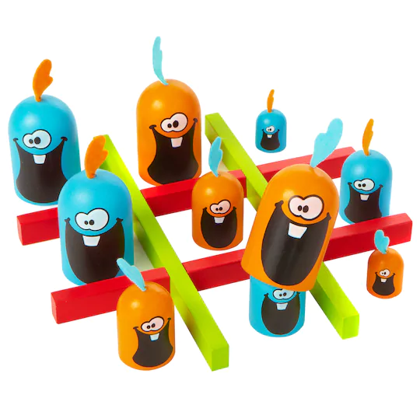



Finding An Optimal Strategy:
Gobblet Gobblers
Patrick O’Doherty Computer Science and Mathematics Major
Weston Rainer Computer Science Major and Mathematics Minor
Faculty Mentor: Axel Brandt Mathematics and Statistics
Symmetry
Ruining the
board game
Gobblet Gobblers
by finding an
optimal strategy
Combinatorial Game Theory
Combinatorial Game Theory (CGT) is the study of sequential games with perfect information
E.g. Tic-Tac-Toe, Connect 4, Checkers, Chess, Go.
In a solved game, the game’s outcome can be predicted under optimal play
E.g. Tic-Tac-Toe ends in a draw
Tree with winners
Gobblet Gobblers
Gobblet Gobblers combines aspects of Tic-Tac-Toe and Gobblet that:
Has 6 pieces per player: two each of small, medium, and large
Allows players to place larger pieces over smaller pieces
Allows players to move their pieces around on the board after being placed
Pieces that are being covered by other, larger pieces cannot be moved
Because a piece must be placed or moved every turn, there are board states that
Player Turn
Check_Wining move for previous move
If yes return winner
Generate list of legal moves
For each legal move
isSymmetric
get known winner
increase winner counter
else
add to conical
iterate player turn
get winner
return winner
Methods
Computational Depth First Search
Backtracking
Symmetry
Programming Results
C program suggests player 2 can always win
Sage Math supports visualization
Acknowledgements
Project funded in part by a CINSAM research grant and the Department of Mathematics and Statistics
Peter Tseng, author of a basic version of Gobblet Gobblers
Future Work
Confirm accuracy of existence result
Determine exact strategy for player 2
Scan to download poster

